Slide 1
WIPRO NGA Program – LSP Batch
Capstone Project Presentation – 19 July 2024
Project Title Here – Compliance and Reporting Microservice
Presented by – Team D
Haranandh Baggam
Amulya Barupati
Akasam Yaswanth
Begari Akhil
Palasa Akhila Goud
G Bharath Kumar
Bahzath Farhana
Bevara kishore kumar
www. rpsconsulting . in

Slide 2

Introduction
Introduction: Overall Project Objective :
The Device Configuration Compliance Analysis project focuses on ensuring that organizational devices comply with predefined rules and standards.
By automatically analyzing device configurations and generating detailed compliance reports, the project identifies non-compliant configurations and provides actionable insights for resolution.
This enhances security, operational efficiency, and adherence to regulatory requirements, empowering organizations to maintain a robust and compliant IT infrastructure.
2024 - RPS Consult ing all r ights reserved
1

Slide 3
Background and Justification
In today's digital landscape, organizations rely heavily on various devices to maintain their operations.
Ensuring these devices comply with security and operational standards is crucial for protecting sensitive data, maintaining system integrity, and meeting regulatory requirements.
Non-compliant configurations can lead to security vulnerabilities, operational inefficiencies, and legal repercussions.
The Device Configuration Compliance Analysis project addresses these challenges by providing a systematic approach to evaluate and enforce compliance, thereby enhancing overall organizational security and efficiency.
2024 - RPS Consult ing all r ights reserved
2

Slide 4
Project Setup Development Environment
Development Tools:
Java Development Kit (JDK) 17:
Provides the necessary tools for Java development.
Spring Tool Suite (STS):
IDE tailored for Spring development.
Provides built-in support for Spring projects, easing development and debugging.
Maven:
Dependency management and project build tool.
Git:
Version control system for source code management.
MySQL:
Open-source relational database management system.
Used for persistent storage of configuration data.
Supports high availability, scalability, and robust data security.
2024 - RPS Consult ing all r ights reserved
3

Slide 5
Methodology : Procedures and Tools
Requirement Analysis:
Identify key compliance rules and standards relevant to the organization.
Gather device configuration data and define compliance metrics.
System Design:
Develop a scalable architecture using Spring Boot for backend processing.
Design a MySQL database schema to store device configurations and compliance rules.
Data Collection and Storage:
Implement data collection methods to gather device configurations.
Store collected data in the MySQL database for analysis.
2024 - RPS Consult ing all r ights reserved
4

Slide 6
Methodology: Procedures and Tools
Compliance Analysis Engine:
Create algorithms to compare device configurations against predefined compliance rules.
Utilize Hibernate ORM for database interactions and ensure efficient data processing.
Reporting and Insights:
Generate detailed compliance reports using Jasper Reports.
Provide insights into non-compliant configurations and suggest remediation steps.
Testing and Validation:
Perform unit and integration testing using JUnit to ensure system reliability.
Validate the system against various compliance scenarios to ensure accuracy.
2024 - RPS Consult ing all r ights reserved
5

Slide 7
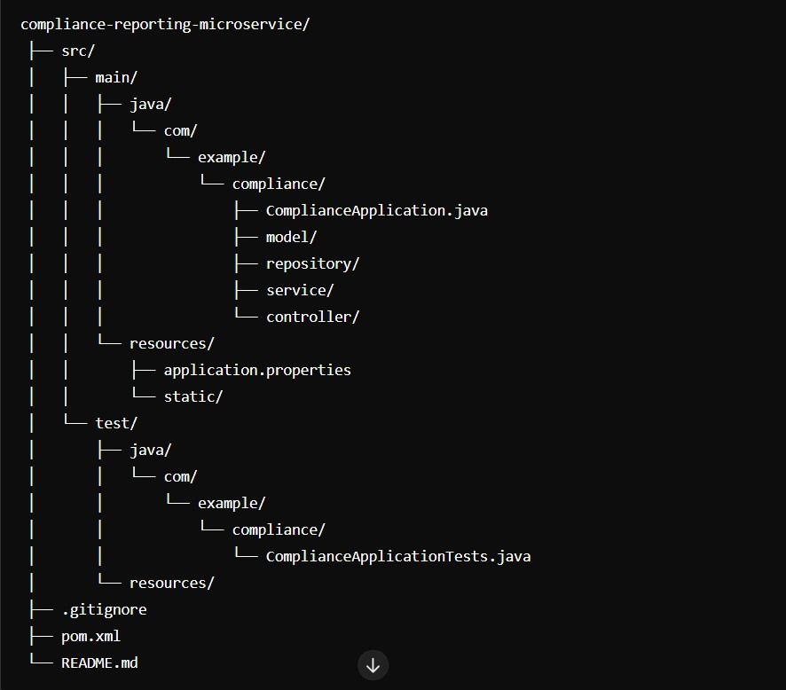
Project Structure
2024 - RPS Consult ing all r ights reserved
6

Slide 8
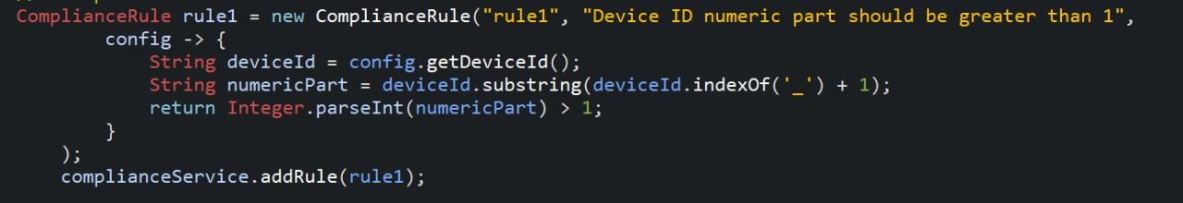
Compliance Rules
Definition:
Compliance involves adhering to a set of standards, regulations, and rules.
Importance:
Ensures security and integrity of systems.
Mitigates risks and prevents violations.
Builds trust and maintains regulatory adherence.
Network Settings:
Configuring network settings to meet security standards.
Network Security:
Setting up firewalls and ensuring secure communication channels.
Configuration Versions:
Ensuring Config Versions.
2024 - RPS Consult ing all r ights reserved
7

Slide 9
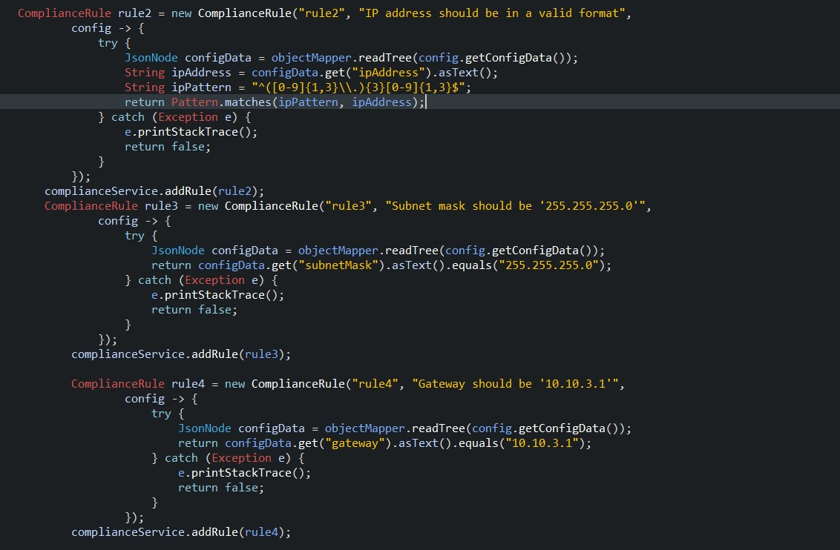
Compliance Rules
2024 - RPS Consult ing all r ights reserved
8

Slide 10
Non-Compliance Rules
Definition:
The compliance rules are predicates that define certain conditions the configuration must meet. If a configuration does not meet these conditions, it is deemed non-compliant.
Situations:
Situations where device configurations do not adhere to compliance rules.
Examples of Non-Compliance
Weak Passwords:
Use of simple or no password protection.
Unauthorized Access:
Permissions granted to unauthorized users.
Unsecured Communication Channels:
Lack of encryption or use of weak encryption methods.
2024 - RPS Consult ing all r ights reserved
9

Slide 11
Alert Service Class :
Significance:
Alerts play a critical role in identifying and addressing compliance issues promptly.
Ensures that important events and potential breaches are communicated to relevant parties.
Description:
Log Alert Method
Send Alert Method
Use Cases:
Compliance Violations
System Monitoring
Security Alerts
2024 - RPS Consult ing all r ights reserved
10

Slide 12
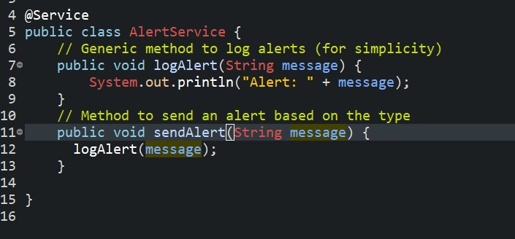
Alert Service Class :
2024 - RPS Consult ing all r ights reserved
11

Slide 13
Configuration of Devices
Definition:
A configuration refers to a set of parameters defining how a device operates within a network.
Purpose:
Dictates the device's behavior.
Ensures compliance with standards.
Manages interaction with other devices.
rules.
Network Settings :
Key Components:
IP Addresses: Unique identifiers for devices on the network.
Subnet Masks: Define network segments and address ranges.
Gateway Settings: Routes traffic between networks.
DNS Servers: Resolve domain names to IP addresses.
2024 - RPS Consult ing all r ights reserved
12

Slide 14
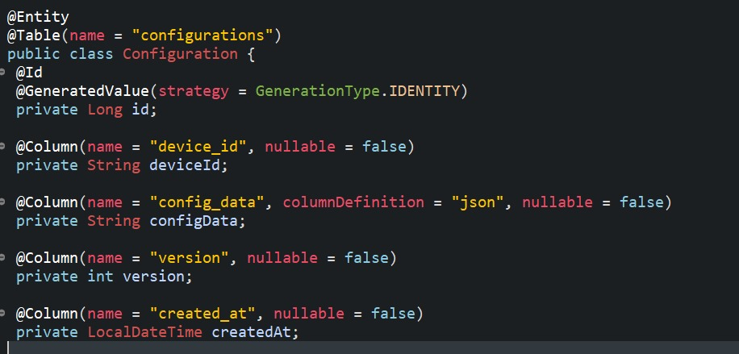
Configuration of Devices
2024 - RPS Consult ing all r ights reserved
13

Slide 15
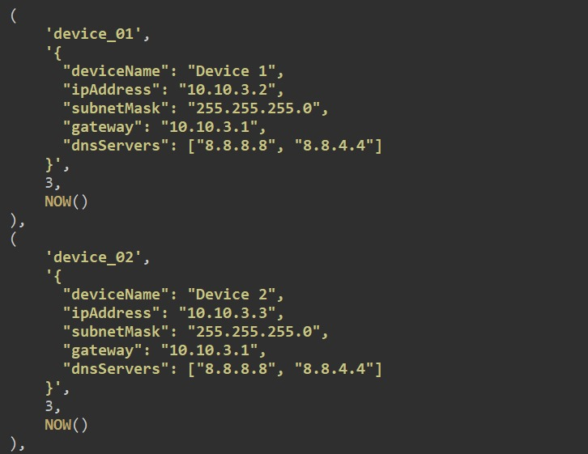
Configuration of Devices
2024 - RPS Consult ing all r ights reserved
14

Slide 16
Compliance Analysis:
Compliance analysis is designed to analyze device configurations against predefined compliance rules.
This service is essential in ensuring that device configurations adhere to specific standards or regulations, thus maintaining the integrity and security of the network.
When the Compliance Service is instantiated, it is provided with a list of compliance rules which it stores internally.
It allows for flexible and dynamic rule management, providing a robust mechanism for compliance analysis.
By evaluating configurations against a set of predefined rules, the service helps maintain the integrity and security of the network, ensuring that all devices operate within specified guidelines.
2024 - RPS Consult ing all r ights reserved
15

Slide 17
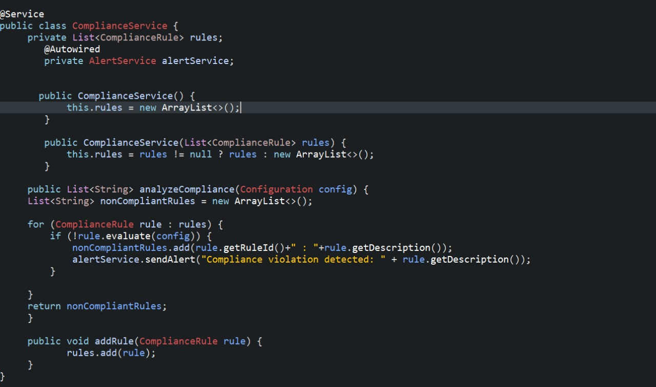
Compliance Analysis:
2024 - RPS Consult ing all r ights reserved
16

Slide 18
Jasper Reports Integration for Report Generation
Overview:
Jasper Reports is a powerful reporting tool that allows for the creation of dynamic, customizable reports.
It supports various output formats like PDF, HTML, XLS, and more.
Setup and Configuration:
Design report templates using tools like Jaspersoft Studio.
Compile .jrxml templates into .jasper files.
Use the Jasper Reports API to fill and export reports
Dependency Configuration:
Add the Jasper Reports dependency in pom.xml for report generation.
Updated dependency
<dependency>
<groupId>net.sf.jasperreports</groupId>
<artifactId>jasperreports</artifactId>
<version>6.17.0</version>
</dependency>
2024 - RPS Consult ing all r ights reserved
17

Slide 19
Reporting Functionalities
Purpose:
Designed to generate compliance reports for device configurations.
Utilizes Jasper Reports to create PDF reports based on configuration data.
Uses:
Auditing
Compliance verification
Record-keeping
Report Service Class
Role:
Crucial component for generating compliance reports in PDF format.
Importance:
Maintains records of compliance checks.
Provides documentation for audits.
Ensures device configurations adhere to required standards.
2024 - RPS Consult ing all r ights reserved
18

Slide 20
Reporting Functionalities
Error Handling:
Designed to handle errors gracefully.
Logs and manages issues during report generation.
Steps in Reporting Process
Data Collection:
Gather configuration data from the database.
Template Compilation:
Compile Jasper Reports templates into .jasper files.
Report Generation:
Use Report Service to fill and export reports as PDF documents.
Error Management:
Log and handle any errors that occur during the process.
2024 - RPS Consult ing all r ights reserved
19

Slide 21
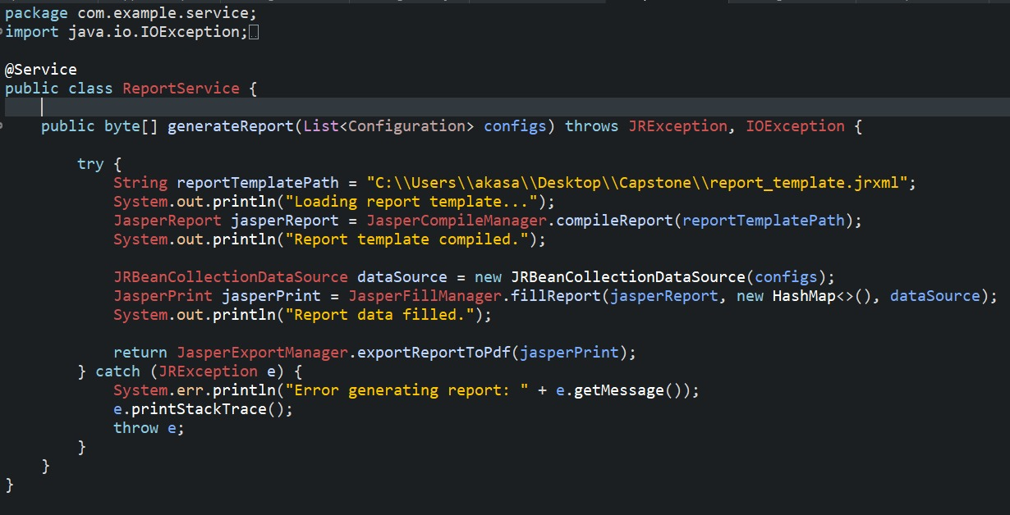
Reporting Functionalities
2024 - RPS Consult ing all r ights reserved
20

Slide 22






Device Configuration Compliance Analysis​
Security and Operational Standards
Spring Boot
MySQL Database
Hibernate ORM
MIND MAP
Requirement Analysis
System Design
Compliance Rules
Configuration of Devices
Compliance Reports
Jasper Reports
Unit Testing​
21

Slide 23
Conclusion
We have effectively developed the Compliance and Reporting Microservice, which will be responsible for analyzing device configurations against predefined compliance rules and generating detailed compliance reports. The development process included integrating of the microservice with the User Interface Microservice, implementing alerting mechanisms, and conducting thorough testing. This approach will ensure the delivery of a reliable and efficient solution for compliance and reporting.
2024 - RPS Consult ing all r ights reserved
22

Slide 24

2024 - RPS Consulting all rights reserved

